Slide 2
Matrix Video Surveillance Solution for Manufacutring Industry

Slide 3
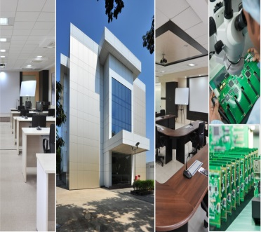
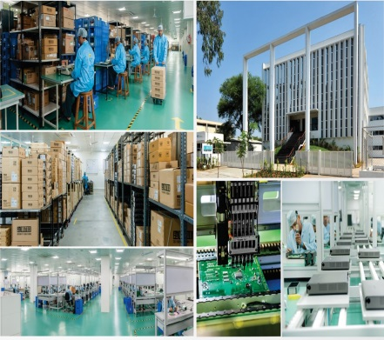
About Matrix
Established in 1991
Products: 60+ Telecom and Security Solutions
Global Presence: 40+ Countries
No. of Partners: 500+
No of Employees: 500+
Awards and Achievements: 25+ for Excellence in Product Engineering,
Design and Innovation
www.MatrixComSec.com
CORPORATE OFFICE
Based at Vadodara, Gujarat, India
Departments: Marketing, Sales, Product Management, Support, Finance,
Customer Care, Purchase
R&D CENTER
77,000 Sq.Ft
More than 40% Manpower in R&D, 700+ Man-years of R&D Experience
World-class Technology Platform and Processes
MANUFACTURING UNIT
73,000 Sq.Ft
100+ Work Stations
International Quality Systems and Processes

Slide 4
Why Matrix?
Higher Business Revenue
Centralized
Control
Safeguard
Investment
Preventive
Security
Process
Optimization
Matrix Video Surveillance Solution for Manufacturing Inustry

Slide 5
Centralized Control

Slide 6
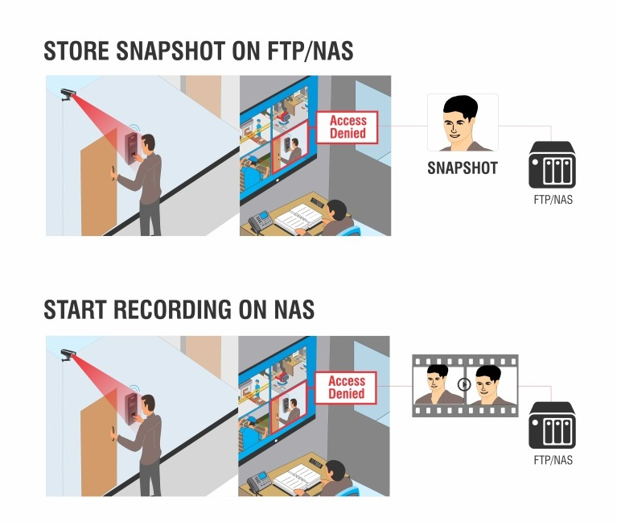
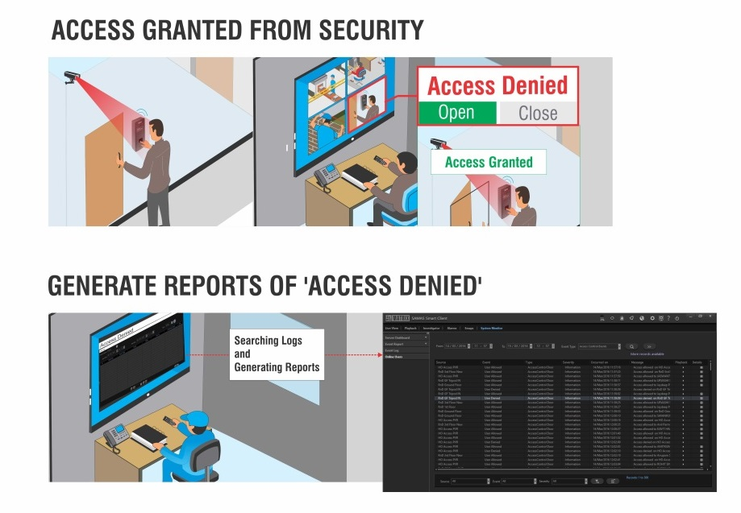
Our Solution
1. Centralized Control
Centralized Control: Flexibility of centralized/de-centralized architecture
Common Security Platform: Any sensor and alarm integration using Aux I/O
Secured Solution: User and application level roles and rights
Centralized Monitoring: Multi-Display Monitor, Video Wall, Cascading
Instant Notification: Quick alerts SMS, Email, Video Pop-up, Audio alerts can be generated

Slide 7
Investment Protection

Slide 8
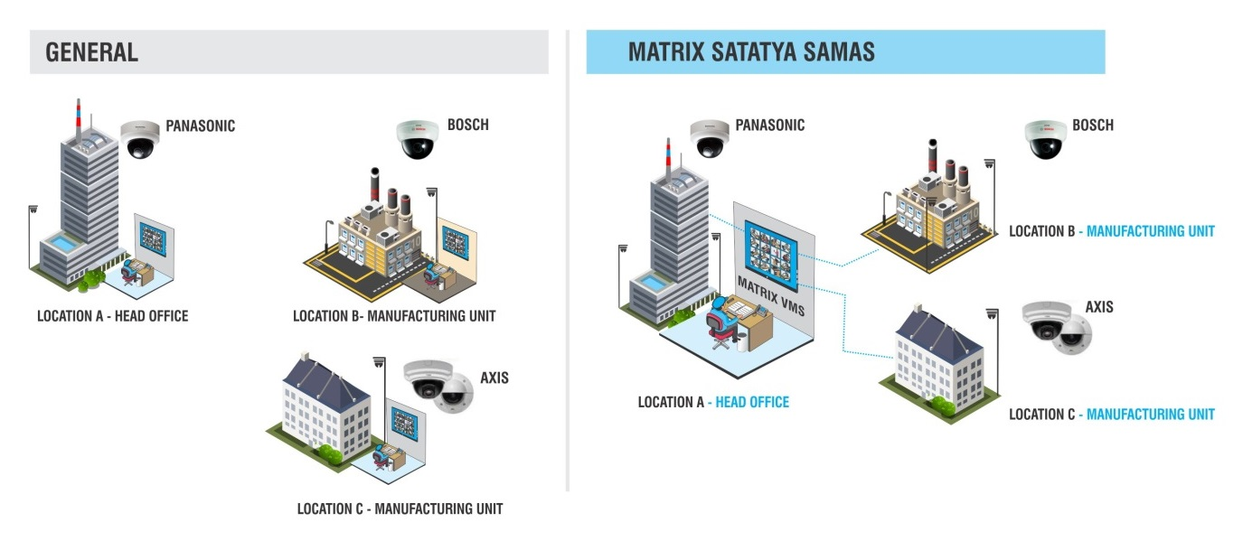
Our Solution
2. Safeguard Investment
Difficulty managing application specific cameras at same or different location?
Multi-brand Camera on a Single Platform: ONVIF support, Camera supported with brand model like Panasonic, Mobotix, Bosch, Pelco, Sony, etc.

Slide 9
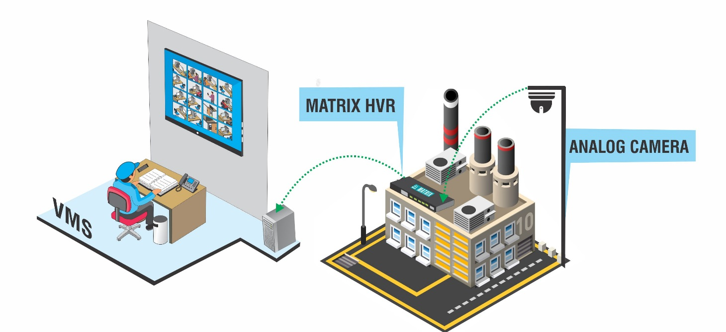
Our Solution
2. Safeguard Investment
Want to upgrade existing analog solution in factory/storage area to VMS without scrapping it?
Analog System on VMS Platform: HVR as a recording server

Slide 10
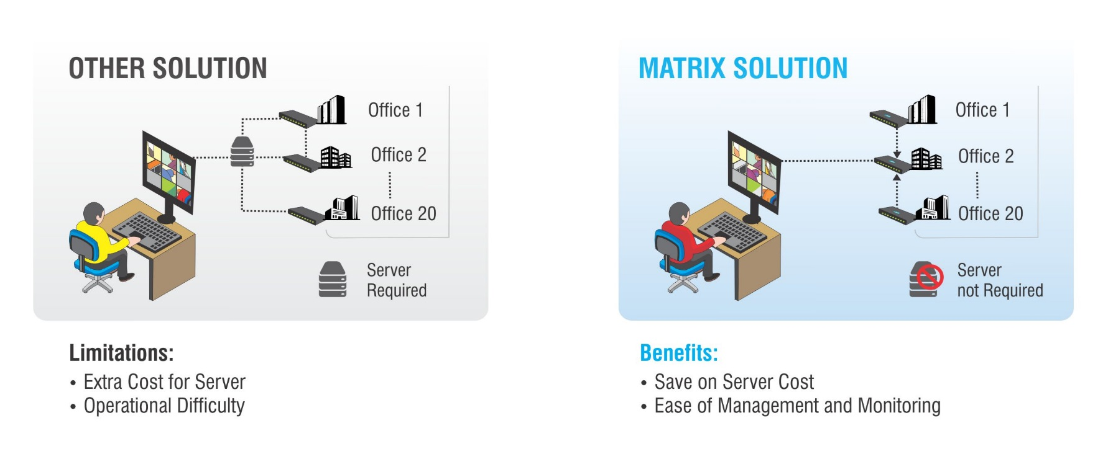
Our Solution
2. Safeguard Investment
Is cost of server for monitoring cameras pinching your pockets?
No Server Needed : Cascading

Slide 11
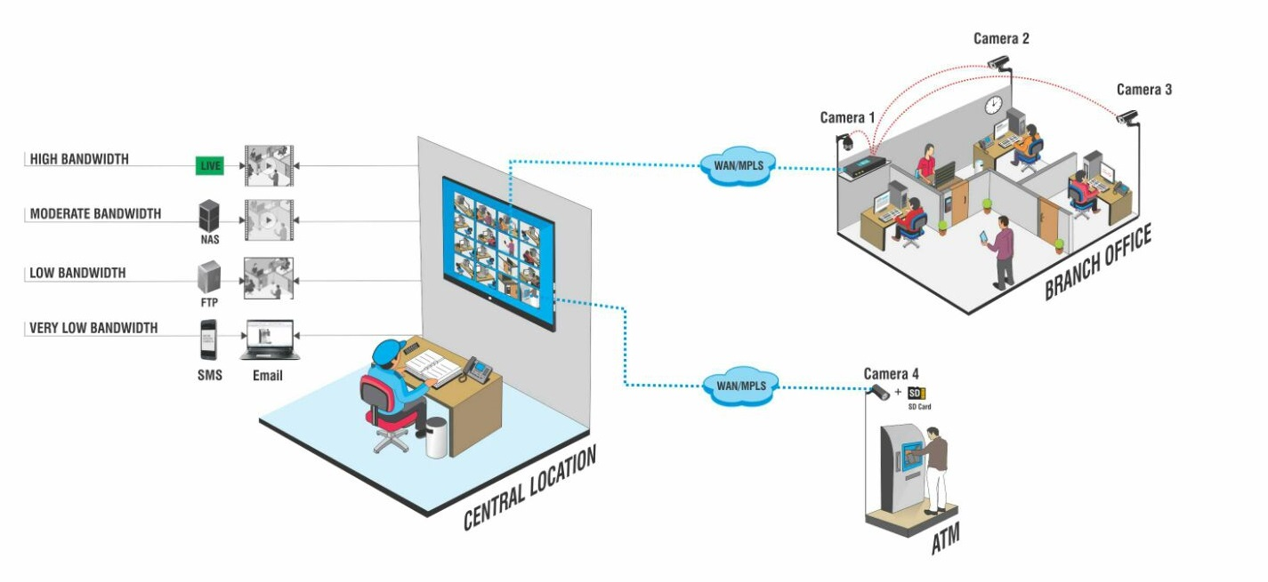
Our Solution
2. Safeguard Investment
Is high bandwidth requirements costing you a fortune monthly?
Recording Flexibility based on Availability of Bandwidth: Edge recording, Event-base clip export
Secure Proof irrespective of Low Bandwidth: Various option to secure proof using Edge recording and other bandwidth optimization function

Slide 12
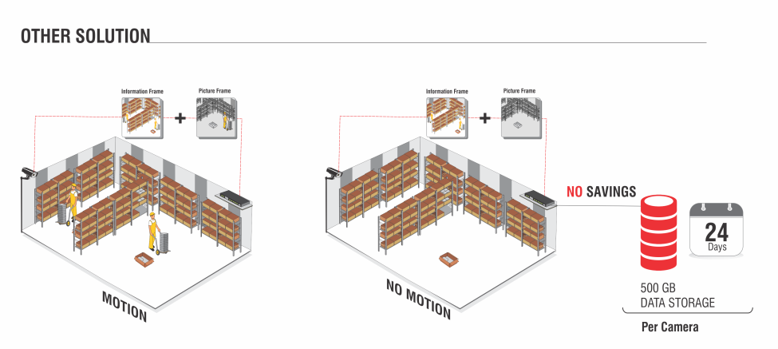
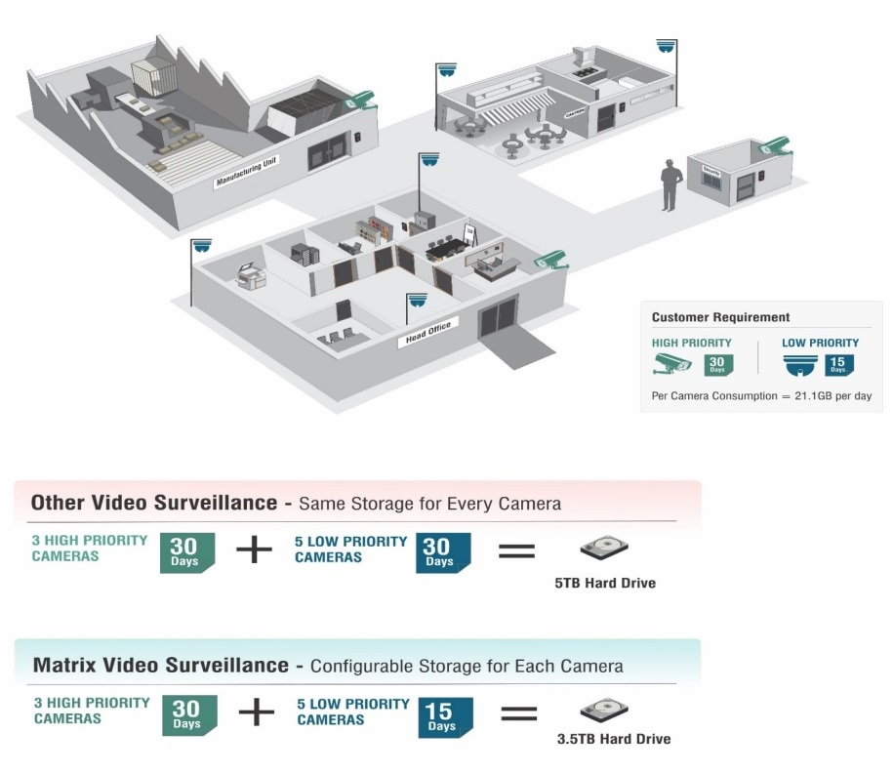
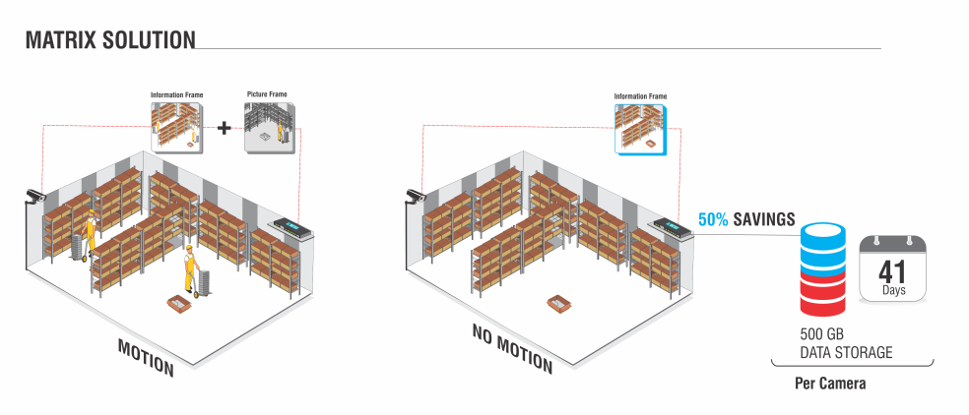
Our Solution
2. Safeguard Investment
Is storage cost preventing you from storing data for months?
Adaptive Recording
Camera-wise recording retention
Save up to 50% Storage Cost : Camera wise recording retention, Adaptive recording

Slide 13
Preventive Security

Slide 14
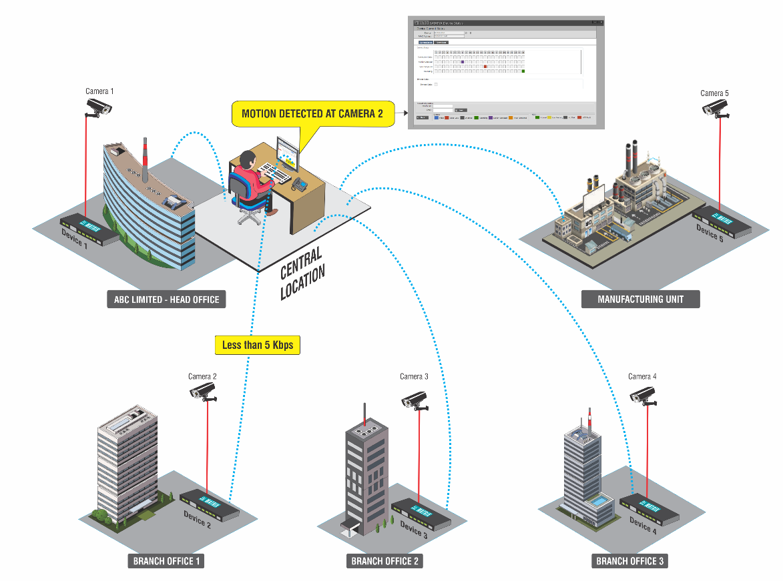
Our Solution
3. Preventive Security
Ensure Lower Breakdowns: TCP notification
Convenient Reporting and Auditing: Report generation, Event Log
Centralized System Maintenance: Health status monitoring

Slide 15
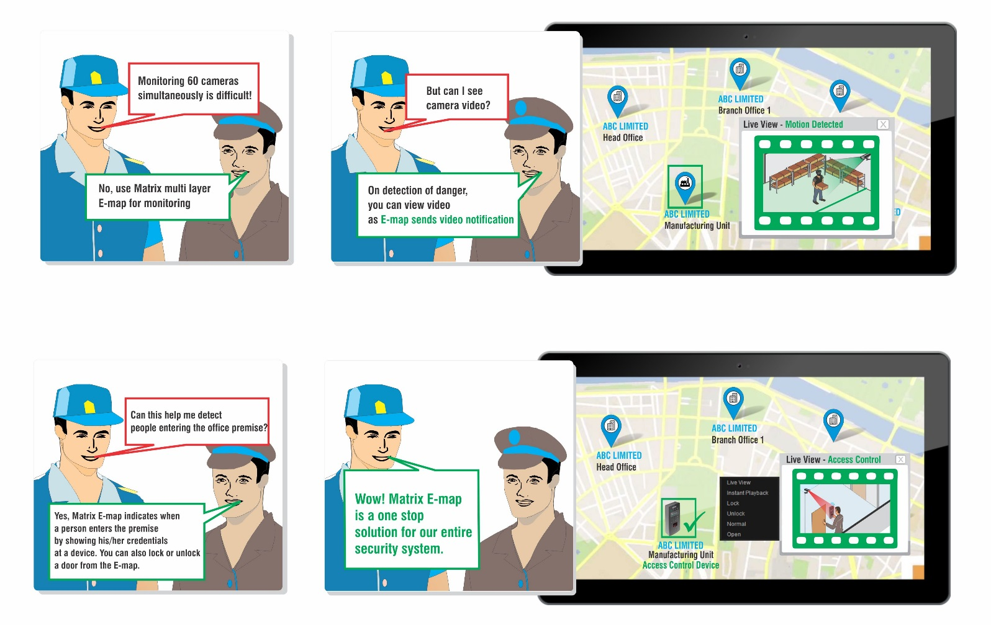
Our Solution
3. Preventive Security
Critical Area Surveillance: E-map, Mobile App, CMS

Slide 16
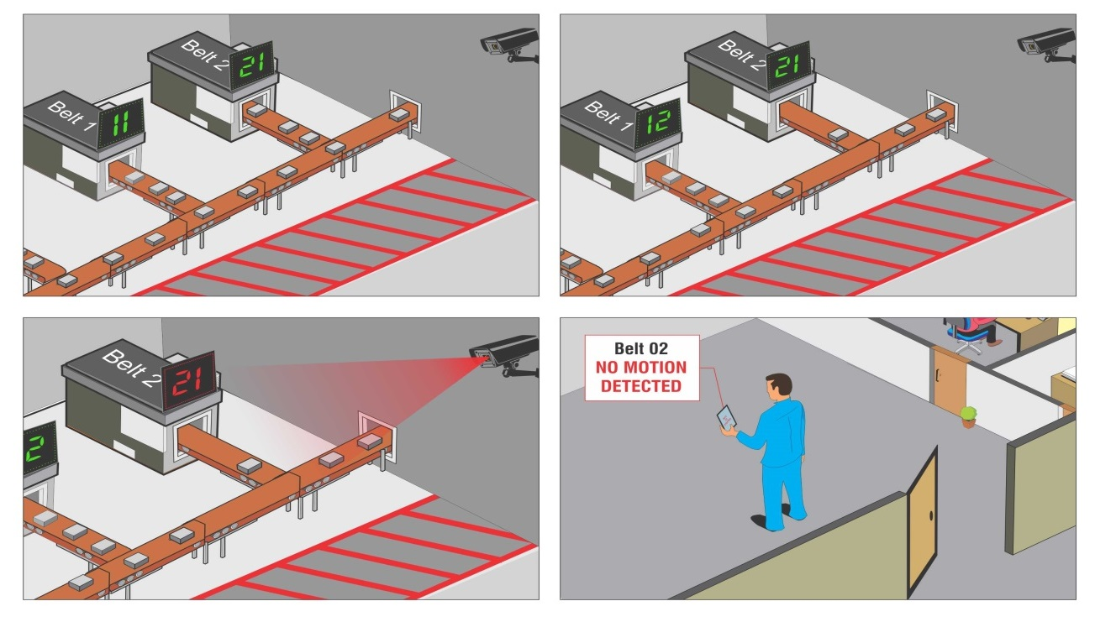
Our Solution
3. Preventive Security
Secure Hazardous Areas to prevent Material or Human Loss : Trip-wire, No motion detection, Intrusion detection, Alert generation, E-map notifications

Slide 17
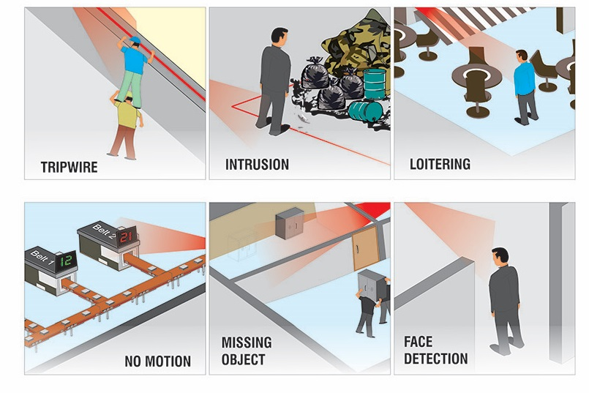
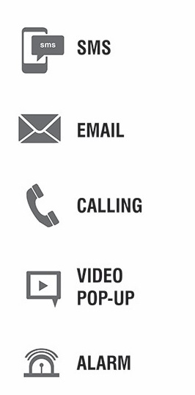
Our Solution
3. Preventive Security
Outer Periphery Monitoring: Trip-wire, Intrusion detection, Sensor-Alarm integration, Loitering
Instant Notification on Intrusion: Video pop-up, Email, SMS, E-map notifications

Slide 18
Process Optimization

Slide 19
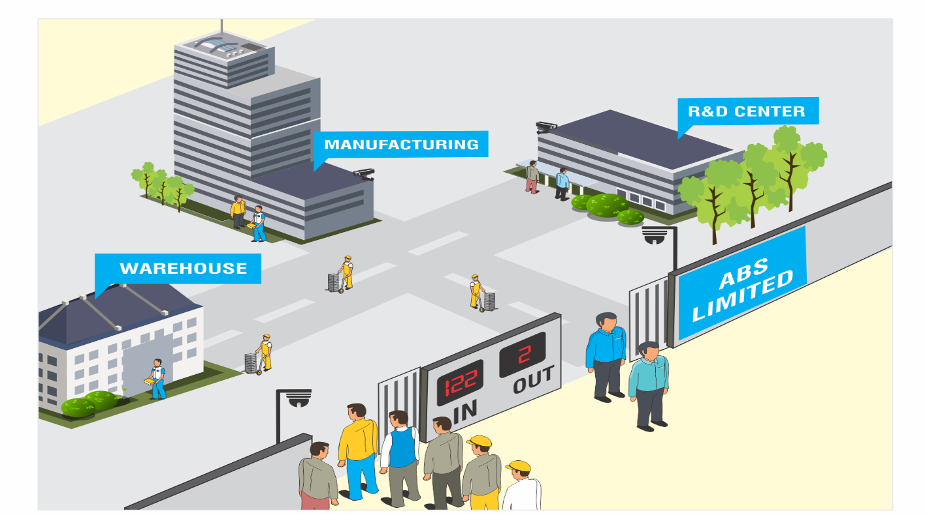
Our Solution
4. Process Optimization
Difficulty in keeping count of people entering/ leaving the premises with manual counters?
Occupancy Control: People counting, Occupancy control

Slide 20
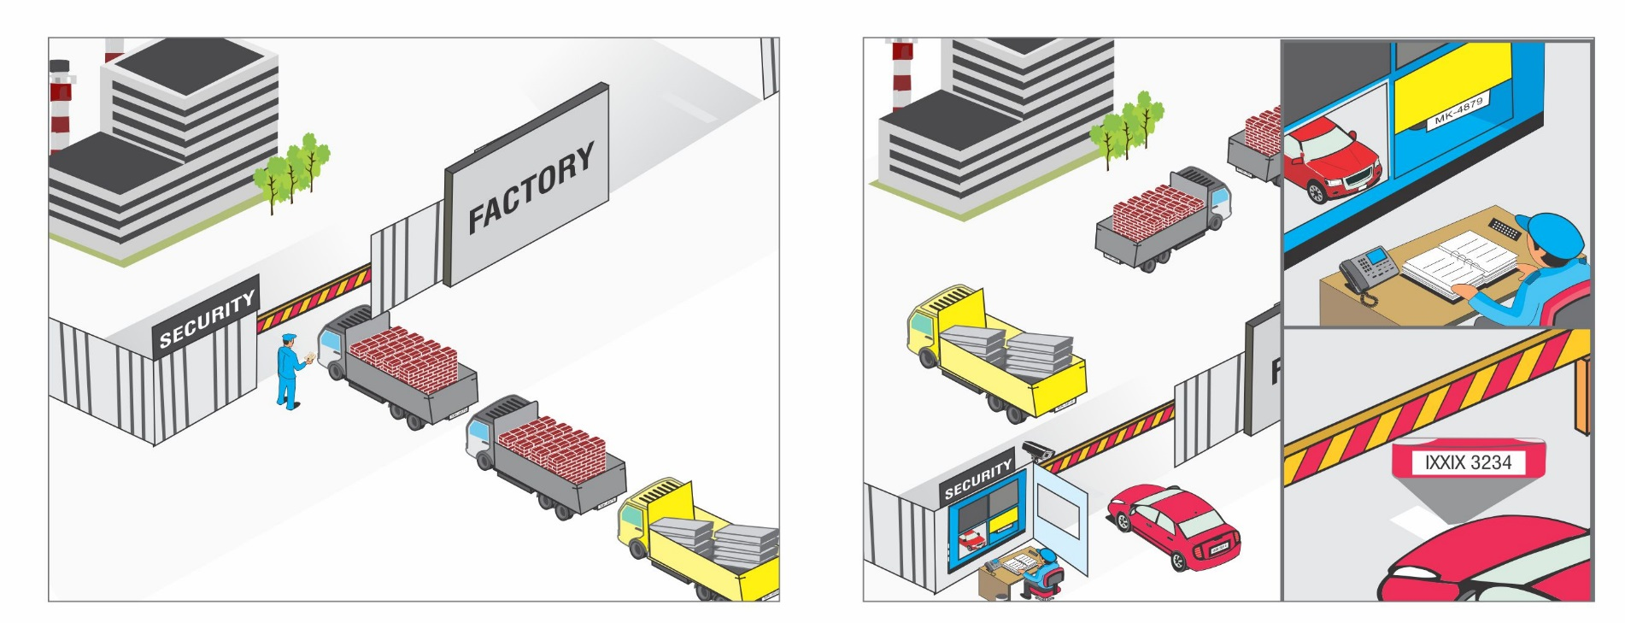
Our Solution
4. Process Optimization
Manual verification of vehicles entering the factory premises slowing down your business operations?
Automatic Vehicle Authorization and Counting: Vehicle counting, LPR, Parking management

Slide 21
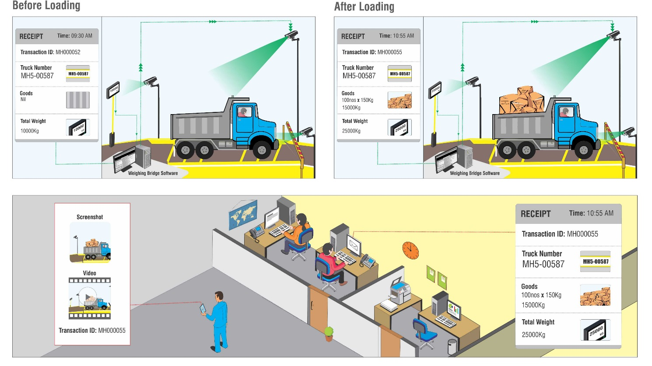
Our Solution
4. Process Optimization
Is data manipulations increasing your input costs?
Prevent Manipulation of Data: Weighbridge integration, LPR recognition, Report generation

Slide 22
Expect More: Value for Money Solution
Centralized Control
Safeguard Protection
Preventive Security
Process Optimization
Thank you

